Slide 1
Language Models
Enabling Machines to Read, Understand, and Generate Human Language

Slide 2
Contents
01
02
Introduction to Language Models
What is a Language Model?
03
04
Why Language Models Are Important
How Language Models Work
05
06
Key Features of Modern LMs
Types of Language Models
07
08
Popular Language Models
Applications Across Industries
09
10
Benefits & Limitations
The Future of Language Models

Slide 3
Introduction to Language Model?
Language Models (LMs) are Artificial Intelligence systems designed to understand, process, and generate human language at scale — now a foundational pillar of modern AI.

Slide 4
What Is a Language Model?
Trained On Massive Text Corpora
Everyday Examples You Already Use
Books and academic papers
Websites and online articles
Research publications
Conversations and dialogues
ChatGPT
Google AI
Conversational AI assistant
AI-enhanced search results
Core Purposes
Grammarly
Siri & Alexa
Understand and predict text
Generate coherent responses
Answer questions contextually
Assist humans in communication
Writing and grammar AI
Voice-based assistants

Slide 5

Language Model- Core Functions
A Language Model predicts the probability of words appearing in a sequence — learning how humans use language to generate meaningful, contextually accurate text.
How It Works — A Simple Example
Core Functions
Text Generation
Input: "The capital of France is ___"
Prediction: Paris — selected because it has the highest probability given the full context of the sentence.
Input: "I am going to the ___"
Possible outputs: market, office, school, station — ranked by contextual likelihood.
Produce essays, emails, and reports
Text Completion
Fill in missing or partial content
Question Answering
Respond accurately to user queries
Translation & Summarization
Convert and condense across languages

Slide 6
Why Are Language Models Important?
Language Models have fundamentally changed how humans interact with computers — enabling natural, intelligent, and efficient communication at unprecedented scale.
Human-Like Communication
Faster Information Access
Automation at Scale
Machines now interact naturally, reducing the need for technical commands or structured queries.
Users receive direct, synthesized answers instead of browsing multiple websites.
Repetitive language-based tasks — drafting, summarizing, classifying — are automated efficiently.
Improved Productivity
Personalized Assistance
Assists professionals in writing, coding, research, and data analysis — saving hours of work.
Delivers customized responses, recommendations, and insights tailored to individual needs.

Slide 7
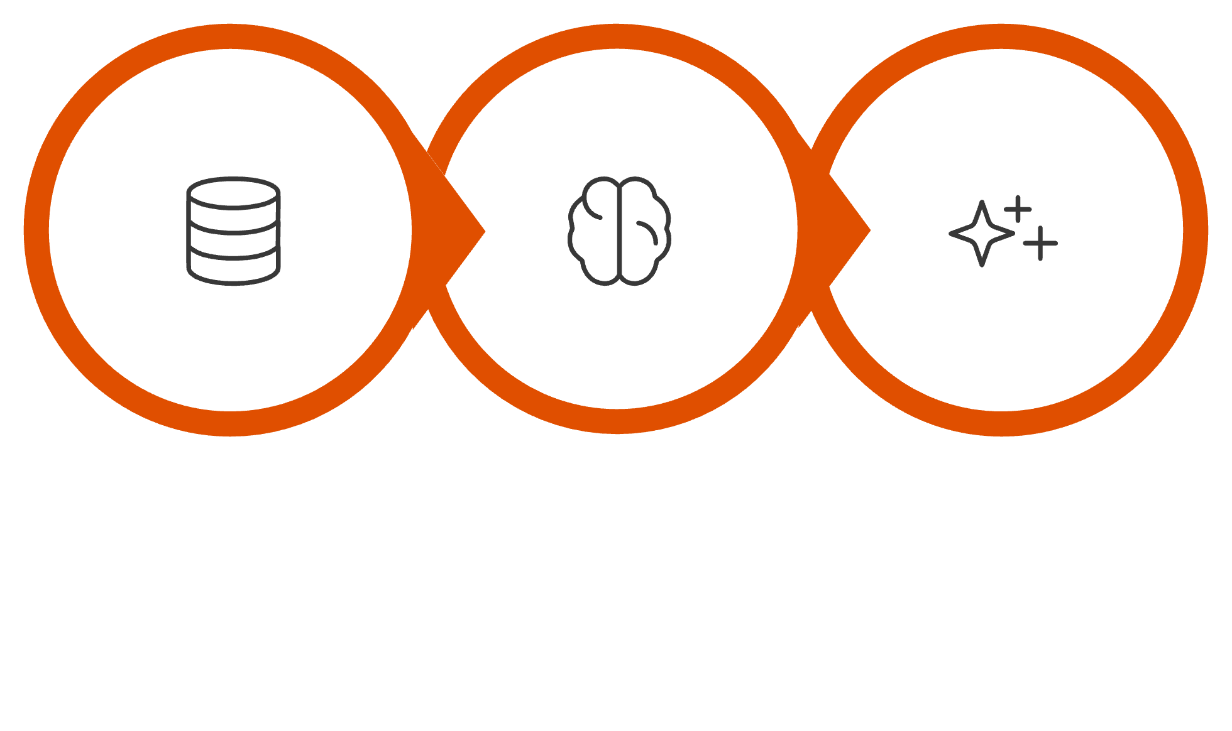

How Language Models Work
Language Models learn statistical patterns from enormous text datasets — building an internal representation of grammar,
meaning, and context.
Train
Learn
Predict
Core Principle: The model does not memorize answers. It generates text based on probability and context — selecting the most likely continuation given everything that came before it.

Slide 8
Key Features of Modern Language Models
1
Context Understanding
Interprets meaning based on surrounding words and full conversational context.
2
Text Generation
Produces essays, emails, reports, and creative stories on demand.
3
Question Answering
Responds to complex user queries in natural, conversational language.
4
Translation
Accurately converts content between hundreds of global languages.
5
Summarization
Condenses large documents into concise, accurate summaries.
6
Multi-Language & Multimodal
Supports global languages and processes text, images, audio, and video.

Slide 9
Types of Language Models
General Purpose
Domain-Specific
Broad tasks and open-ended conversations across any domain.
Examples: ChatGPT, Gemini, Claude
Specialized for high-stakes industries requiring precision.
Examples: Medical AI, Legal AI, Financial AI
Conversational
Multimodal
Optimized for interactive, real-time chat and dialogue.
Examples: AI Chatbots, Virtual Assistants
Process and reason across text, images, audio, and video.
Examples: GPT-4o, Gemini

Slide 10

Popular Language Models
Leading Commercial Models
Open Source Models
Organization
Model(s)
Mistral
Falcon
OpenAI
GPT-3, GPT-4, ChatGPT
High-performance European open model
UAE-developed open-source LLM
Google
Gemini, BERT, PaLM
Anthropic
Claude
BLOOM
Meta
LLaMA
Multilingual, community-built model
Microsoft
Copilot AI
All models share core capabilities: writing, coding, research, summarization, and question answering.

Slide 11
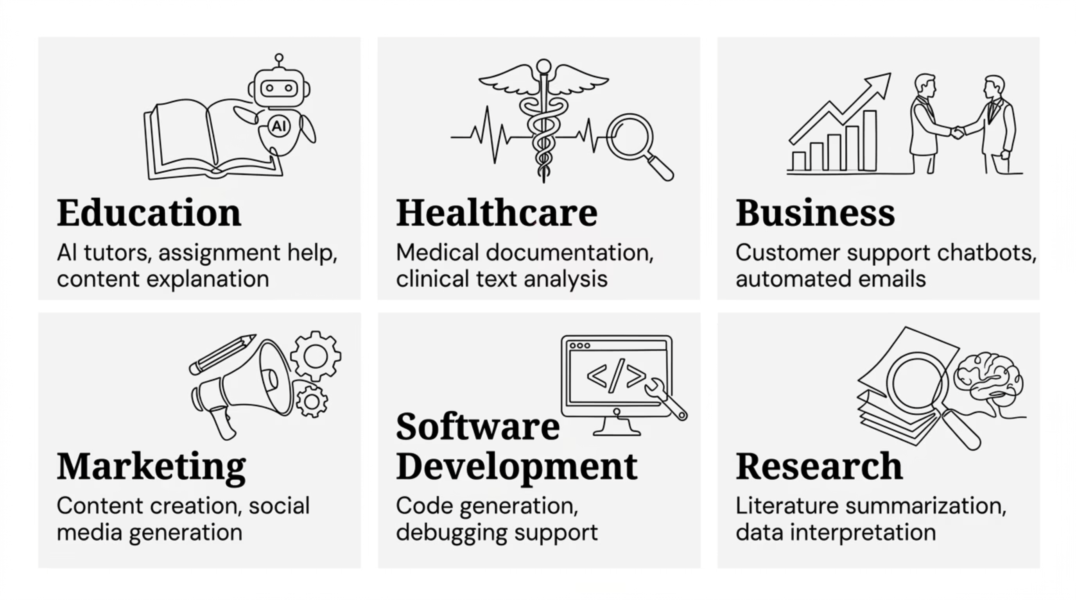
Applications Across Industries
Language Models are now embedded across every major sector — transforming how professionals work, communicate,
and make decisions.

Slide 12
Benefits & Limitations
Key Benefits
Critical Limitations
Faster Content Generation
Hallucinations
Bias in Outputs
Creates high-quality text quickly, reducing manual effort dramatically.
May confidently generate factually incorrect information.
Reflects biases present in the underlying training data.
24/7 Availability
Always available — no downtime, no fatigue, consistent performance.
Data Privacy
No True Understanding
Sensitive inputs must be handled with strict governance.
Models predict patterns — they do not reason like humans.
Supports Decision Making
Delivers rapid insights, summaries, and analysis
on demand.
High Compute Cost
Training and inference require powerful, expensive infrastructure.

Slide 13
The Future of Language Models
The next generation of Language Models will be more human-like, personalized, multimodal, and deeply embedded in every
professional workflow.
More Human-Like Conversations
1
Improved contextual memory and nuanced understanding across long interactions.
2
Personalized AI Assistants
Deeply customized models that adapt to individual users, preferences, and workflows.
Advanced Multimodal Systems
3
Seamless integration of text, image, audio, and video reasoning in unified models.
4
Industry-Specific AI
Specialized LMs trained for healthcare, finance, law, and education with domain precision.
Real-Time AI Collaboration
5
AI agents working alongside humans as true cognitive partners in daily professional tasks.

Slide 14

Key Takeaways
Foundational Technology
Universal Industry Impact
Rapidly Evolving
Language Models are now a core pillar of modern AI — essential infrastructure for the digital age.
From education and healthcare to finance and software — LMs are transforming every professional domain.
The pace of advancement is accelerating — models are becoming more capable, efficient, and accessible every year.
The bottom line: Language Models are not a distant future technology — they are here, they are powerful, and understanding them is now an essential competency for professionals across every field.

